Slide 1
Programming Logic and Design Seventh Edition
Chapter 3
Understanding Structure
Online c compiler: https://www.onlinegdb.com/online_c_compiler

Slide 2
Objectives
In this chapter, you will learn about:
The disadvantages of unstructured spaghetti code
The three basic structures—sequence, selection, and loop
Using a priming input to structure a program
The need for structure
Recognizing structure
Structuring and modularizing unstructured logic

Slide 3
The Disadvantages of Unstructured Spaghetti Code
Spaghetti code
Logically snarled program statements
Often a complicated mess
Programs often work but are difficult to read and maintain
Confusing and prone to error
Unstructured programs
Do not follow the rules of structured logic
Structured programs
Follow the rules of structured logic

Slide 4
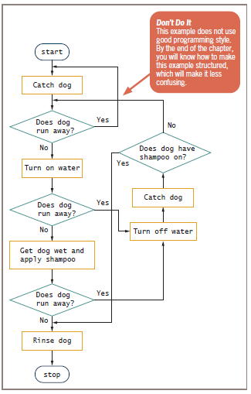
Figure 3-1 Spaghetti code logic for washing a dog

Slide 5
Understanding the Three Basic Structures
Structure
Basic unit of programming logic
Sequence structure
Perform actions in order
No branching or skipping any task
Selection structure (decision structure)
Ask a question, take one of two actions
Dual-alternative ifs or single-alternative ifs
Loop structure
Repeat actions while a condition remains true

Slide 6
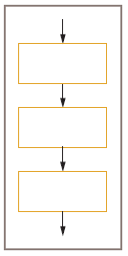
Understanding the Three Basic Structures (continued)
Figure 3-2 Sequence structure

Slide 7
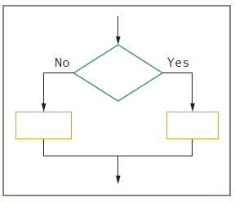
Understanding the Three Basic Structures (continued)
Figure 3-3 Selection structure

Slide 8
Understanding the Three Basic Structures (continued)
Dual-alternative ifs
Contain two alternatives
The if-then-else structure
if someCondition is true then
do oneProcess
else
do theOtherProcess
endif

Slide 9
if Statement in C Online c compiler: https://www.onlinegdb.com/online_c_compiler
#include <stdio.h>
int main ()
{
/* local variable definition */
int a = 10;
/* check the boolean condition using if statement */
if( a < 20 )
{
/* if condition is true then print the following */
printf("a is less than 20\n" );
}
printf("value of a is : %d\n", a);
return 0;
}

Slide 10
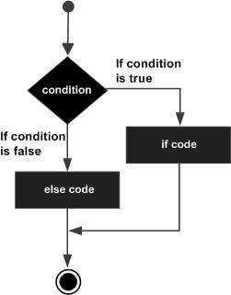
if …… else Statement in C
#include <stdio.h>
int main ()
{
int a = 100;
if( a < 20 )
{
printf("a is less than 20\n" );
}
else
{
/* if condition is false then print the following */
printf("a is not less than 20\n" );
}
printf("value of a is : %d\n", a);
return 0;
}
Flow Diagram

Slide 11
Understanding the Three Basic Structures (continued)
Single-alternative ifs
An else clause is not required
null case
Situation where nothing is done
if employee belongs to dentalPlan then
deduct $40 from employeeGrossPay

Slide 12
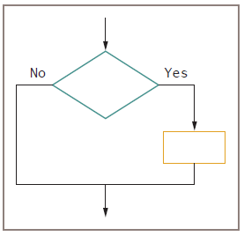
Understanding the Three Basic Structures (continued)
Figure 3-4 Single-alternative selection structure

Slide 13
Understanding the Three Basic Structures (continued)
Loop structure
Repeats a set of actions while a condition remains true
Loop body
Also called repetition or iteration
Condition is tested first in the most common form of loop
The while…do or while loop

Slide 14
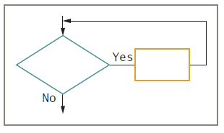
Understanding the Three Basic Structures (continued)
Figure 3-5 Loop structure

Slide 15
Understanding the Three Basic Structures (continued)
Loop structure
while testCondition continues to be true
do someProcess
while you continue to be hungry
take another bite of food
determine if you still feel hungry

Slide 16
Three Types of Loops in C programming
for loop
while loop
do...while loop
The syntax of the for loop is:
The initialization statement is executed only once.
The test expression is evaluated, if it is evaluated to false, the for loop is terminated; If it is evaluated to true, statements inside the body of for loop are executed, and the update expression is updated.
Again the test expression is evaluated.
This process goes on until the test expression is false then the loop terminates.
Example:
#include <stdio.h>
int main()
{
int i;
for (i = 0; i< 10; ++i)
printf ("i = %d; ", i);
return 0;
}
for (initializationStatement; testExpression; updateStatement)
{
// statements inside the body of loop
}

Slide 17
Example
For increasing the counter by 1 and decreasing by 1:
++i prefix: the value of i is increamented by 1 and then is used in the following calculations.
i++ postfix: the current value of i is used in the calculations and after that the value of i will be increamented by 1.
Simillar situation for --i and i--;
Example:
#include <stdio.h>
int main()
{
int i;
for (i = 0; i< 10; ++i)
printf ("i = %d; ", i);
return 0;
}
i = i + 3 is equivalent to: i += 3
Notes:
% modulo operator in C, It will give the remainder of 23 % 4 that result in 3.

Slide 18
for loop: Example 1
#include <stdio.h>
int main()
{ // Print numbers from 1 to 10
int i;
for (i = 1; i < 11; ++i)
{
printf("%d ,", i);
}
return 0;
}
Output: 1, 2, 3, 4, 5, 6, 7, 8, 9, 10,
i is initialized to 1.
The expression i < 11 is evaluated. Since 1 less than 11 is true, the body of for loop is executed. This will print the 1 (value of i) on the screen.
The update statement ++i is executed. Now, the value of i will be 2. Again, the expression is evaluated to true, and the body of for loop is executed. This will print 2 (value of i) on the screen, again and again until i becomes 11.
When i becomes 11, i < 11 will be false, and the for loop terminates.
#include <stdio.h>
int main()
{ // Print numbers from 1 to 10
int i;
for (i = 1; i < 11; ++i)
printf("%d ", ++i);
return 0;
}
Replace i in the printf with ++i then the output: 2, 4, 6,8, 10,

Slide 19
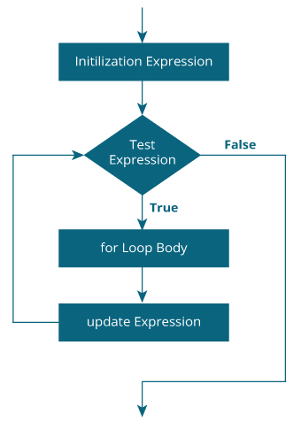
for loop: Example 2
// Program to calculate the sum of first n natural numbers
// Positive integers 1,2,3...n are known as natural numbers
#include <stdio.h>
int main()
{
int num, count, sum = 0;
printf("Enter a positive integer: ");
scanf("%d", &num);
// for loop terminates when num is less than count
for(count = 1; count <= num; ++count)
{
sum = sum+count;
}
printf("Sum = %d", sum);
return 0;
}
for loop Flowchart
Output: Enter a positive integer: 10 Sum = 55

Slide 20
for loop: Example 3
Output: i = 1
sum = 1
i = 2
sum = 3
i = 3
sum = 6
i = 4
sum = 10
i = 5
sum = 15
i = 6
sum = 21
i = 7
sum = 28
i = 8
sum = 36
i = 9
sum = 45
i = 10
sum = 55
1.
#include <stdio.h>
int main()
{
// Print numbers from 1 to 10
int i, sum;
sum = 0;
for (i = 1; i < 11; ++i)
{
sum = sum + i;
printf("%d \n %d \n", i, sum);
}
return 0;
}
2.
#include <stdio.h>
int main()
{
int i, r;
// r : radius of the Circle
float pi = 3.14;
float s;
// s : area of the Circle
for (i = 0; i< 10; ++i)
{
r = 2 * i;
s = pi * r * r;
printf ("i = %d ; s = %f ;\n", i, s);
}
return 0;
}
Output:
i=0; s=0.000000;
i=1; s=12.560000;
i=2; s=50.240002;
i=3; s=113.040001; i=4; s=200.960007; i=5; s=314.000000; i=6; s=452.160004; i=7; s=615.440063; i=8; s=803.840027; i=9; s=1017.359985;

Slide 21
Understanding the Three Basic Structures (continued)
All logic problems can be solved using only sequence, selection, and loop
Structures can be combined in an infinite number of ways
Stacking structures
Attaching structures end-to-end
End-structure statement
Indicates the end of a structure
The endif statement ends an if-then-else structure
The endwhile statement ends a loop structure

Slide 22
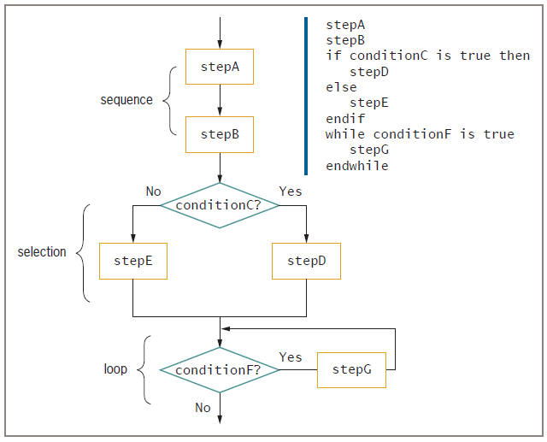
Understanding the Three Basic Structures (continued)
Figure 3-6 Structured flowchart and pseudocode with three stacked structures

Slide 23
Understanding the Three Basic Structures (continued)
Any individual task or step in a structure can be replaced by a structure
Nesting structures
Placing one structure within another
Indent the nested structure’s statements
Block
A group of statements that execute as a single unit

Slide 24
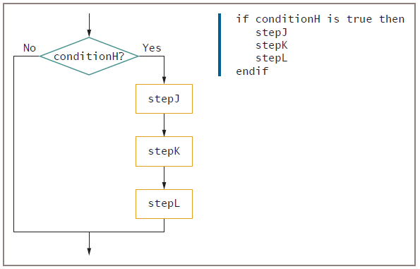
Understanding the Three Basic Structures (continued)
Figure 3-7 Flowchart and pseudocode showing nested structures— a sequence nested within a selection

Slide 25
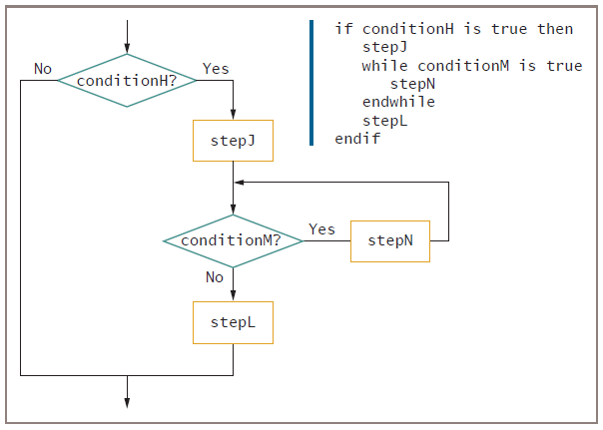
Understanding the Three Basic Structures (continued)
Figure 3-8 Flowchart and pseudocode showing nested structures—
a loop nested within a sequence, nested within a selection

Slide 26
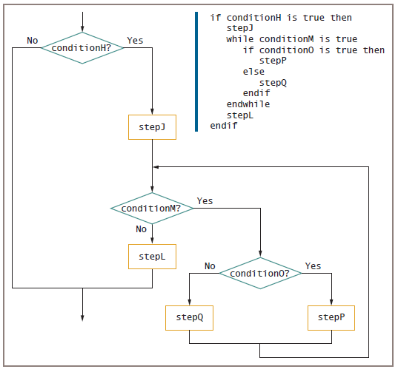
Understanding the Three Basic Structures (continued)
Figure 3-9 Flowchart and pseudocode for a selection within
a loop within a sequence within a selection

Slide 27
Understanding the Three Basic Structures (continued)
Structured programs have the following characteristics:
Include only combinations of the three basic structures
Each structure has a single entry point and a single exit point
Structures can be stacked or connected to one another only at their entry or exit points
Any structure can be nested within another structure

Slide 28
Using a Priming Input to Structure a Program
Priming input (or priming read)
Reads the first input data record
Is outside the loop that reads the rest of the records
Helps keep the program structured
Analyze a flowchart for structure one step at a time
Watch for unstructured loops that do not follow this order
First ask a question
Take action based on the answer
Return to ask the question again

Slide 29
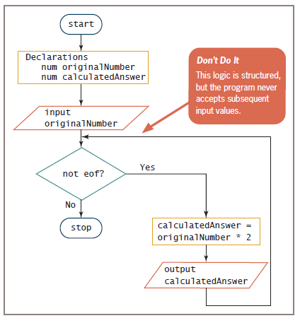
Using a Priming Input to Structure a Program (continued)
Figure 3-15 Structured, but nonfunctional, flowchart of number-doubling problem

Slide 30
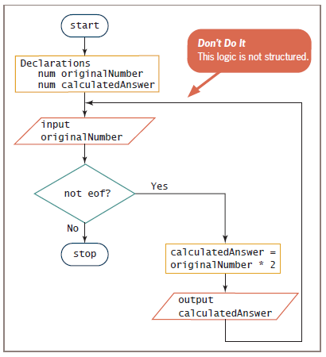
Using a Priming Input to Structure a Program (continued)
Figure 3-16 Functional but unstructured flowchart

Slide 31
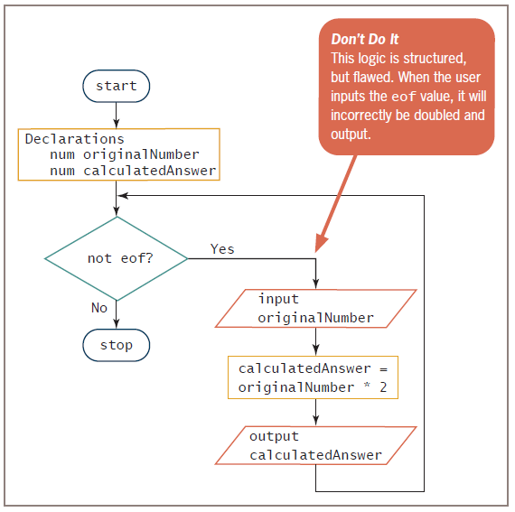
Figure 3-18 Structured but incorrect solution to the number-doubling problem

Slide 32
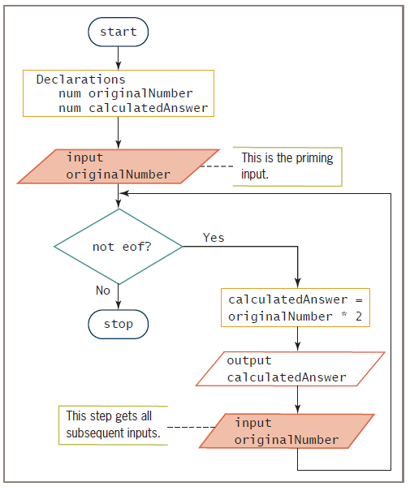
Figure 3-17 Functional, structured flowchart for the number-doubling problem

Slide 33
Understanding the Reasons for Structure
Clarity—unstructured programs are confusing
Professionalism—other programmers expect it
Efficiency—most languages support it
Ease of maintenance—other programmers find it easier to read
Supports modularity—easily broken down into modules
It can be difficult to detect whether a flowchart is structured

Slide 34
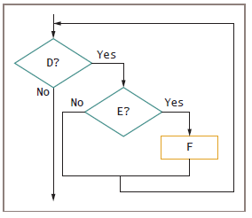
Recognizing Structure
A Structured Flowchart
Figure 3-20 Example 2

Slide 35
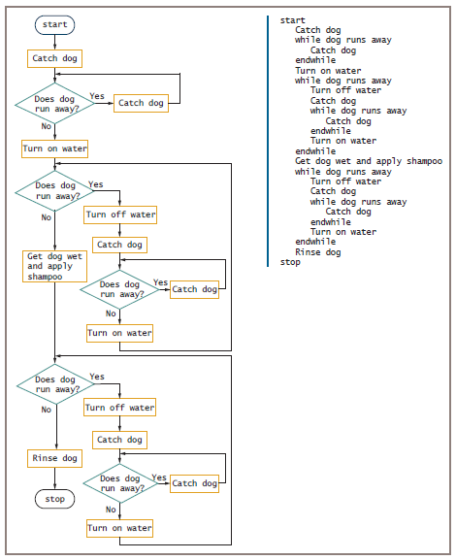
Figure 3-23 Structured dog-washing flowchart and pseudocode

Slide 36
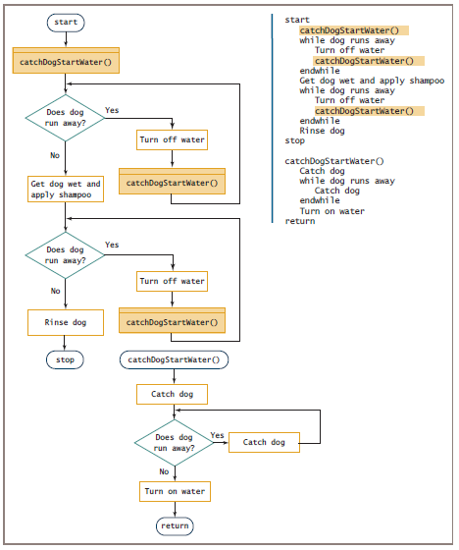
Figure 3-24 Modularized version of the dog-washing program

Slide 37
Summary
Spaghetti code
Statements that do not follow rules of structured logic
Three basic structures
Sequence, selection, and loop
Combined by stacking and nesting
Priming input
Statement that reads the first input value prior to starting a structured loop

Slide 38
Summary (continued)
Structured techniques promote:
Clarity
Professionalism
Efficiency
Modularity
Flowcharts can be made structured by untangling
Logical steps can be rewritten to conform to the three structures

Slide 39
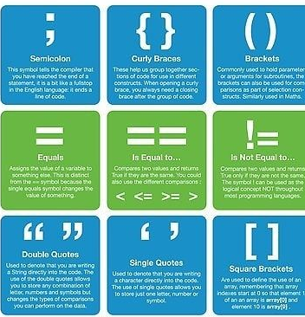
Programming Symbols

Slide 40
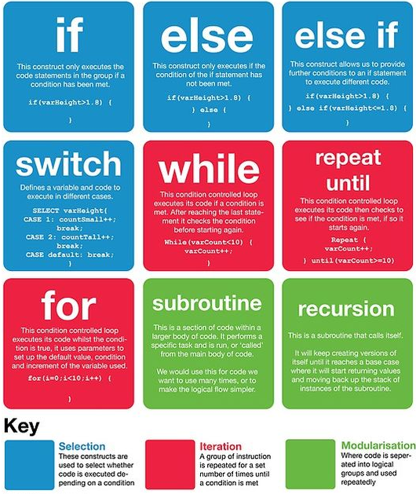
Programming Constructs

Slide 41
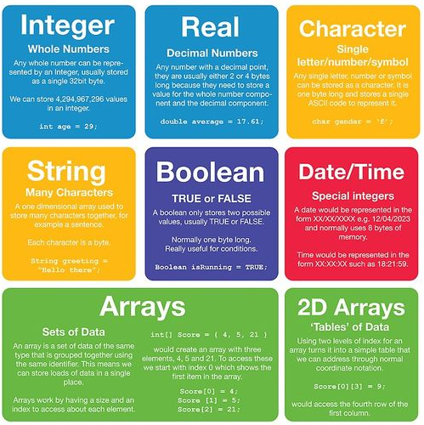
Programming Data Types

